Slide 1
뉴스 웹
모바일소프트웨어학과 강형석

Slide 2
요구사항
유저가 뉴스 웹을 접속한다
유저가 관심있어 하는 카테고리를 선택한다
흥미로운 기사에 좋아요를 누른다.
자신의 좋아요 개수를 확인한다.

Slide 3
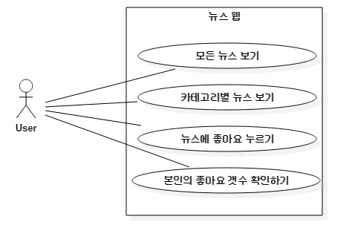
Use-case

Slide 4
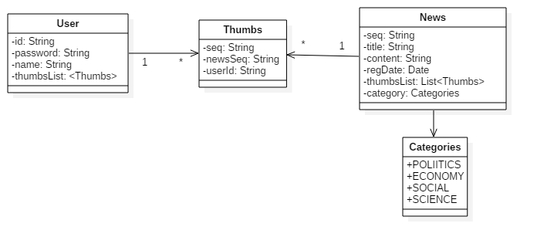
Class diagram – Domain

Slide 5
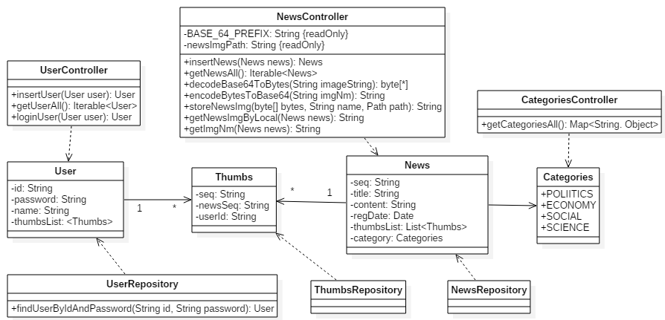
Class diagram

Slide 6
UI 설계도 - main
News Web<img>
Sign Up / Sign In
User List
Post News
News List
Categories1
Welcome News Web
sign in / sign up
See news
Categories2
Categories3
FOOTER

Slide 7
UI 설계도 – sign up /sign in
News Web<img>
Sign Up / Sign In
User List
Post News
News List
Sign in
id
password
Sign up
id
password
Password 확인
name
FOOTER

Slide 8
UI 설계도 – userlist
News Web<img>
Sign Up / Sign In
User List
Post News
News List
id
Name
Thumbs count
id1
name1
1
id2
name2
2
·
·
·
FOOTER

Slide 9
UI 설계도 – post news
News Web<img>
Sign Up / Sign In
User List
Post News
News List
Posting news
category
Please select one
title
content
News image
Click or drag image
Image preview
FOOTER

Slide 10
UI 설계도 – userlist
News Web<img>
Sign Up / Sign In
User List
Post News
News List
News image
News image
date
Thums up
date
Thums up
title
title
content
content
News image
News image
FOOTER
date
Thums up
date
Thums up
title
title
content
content

Slide 11
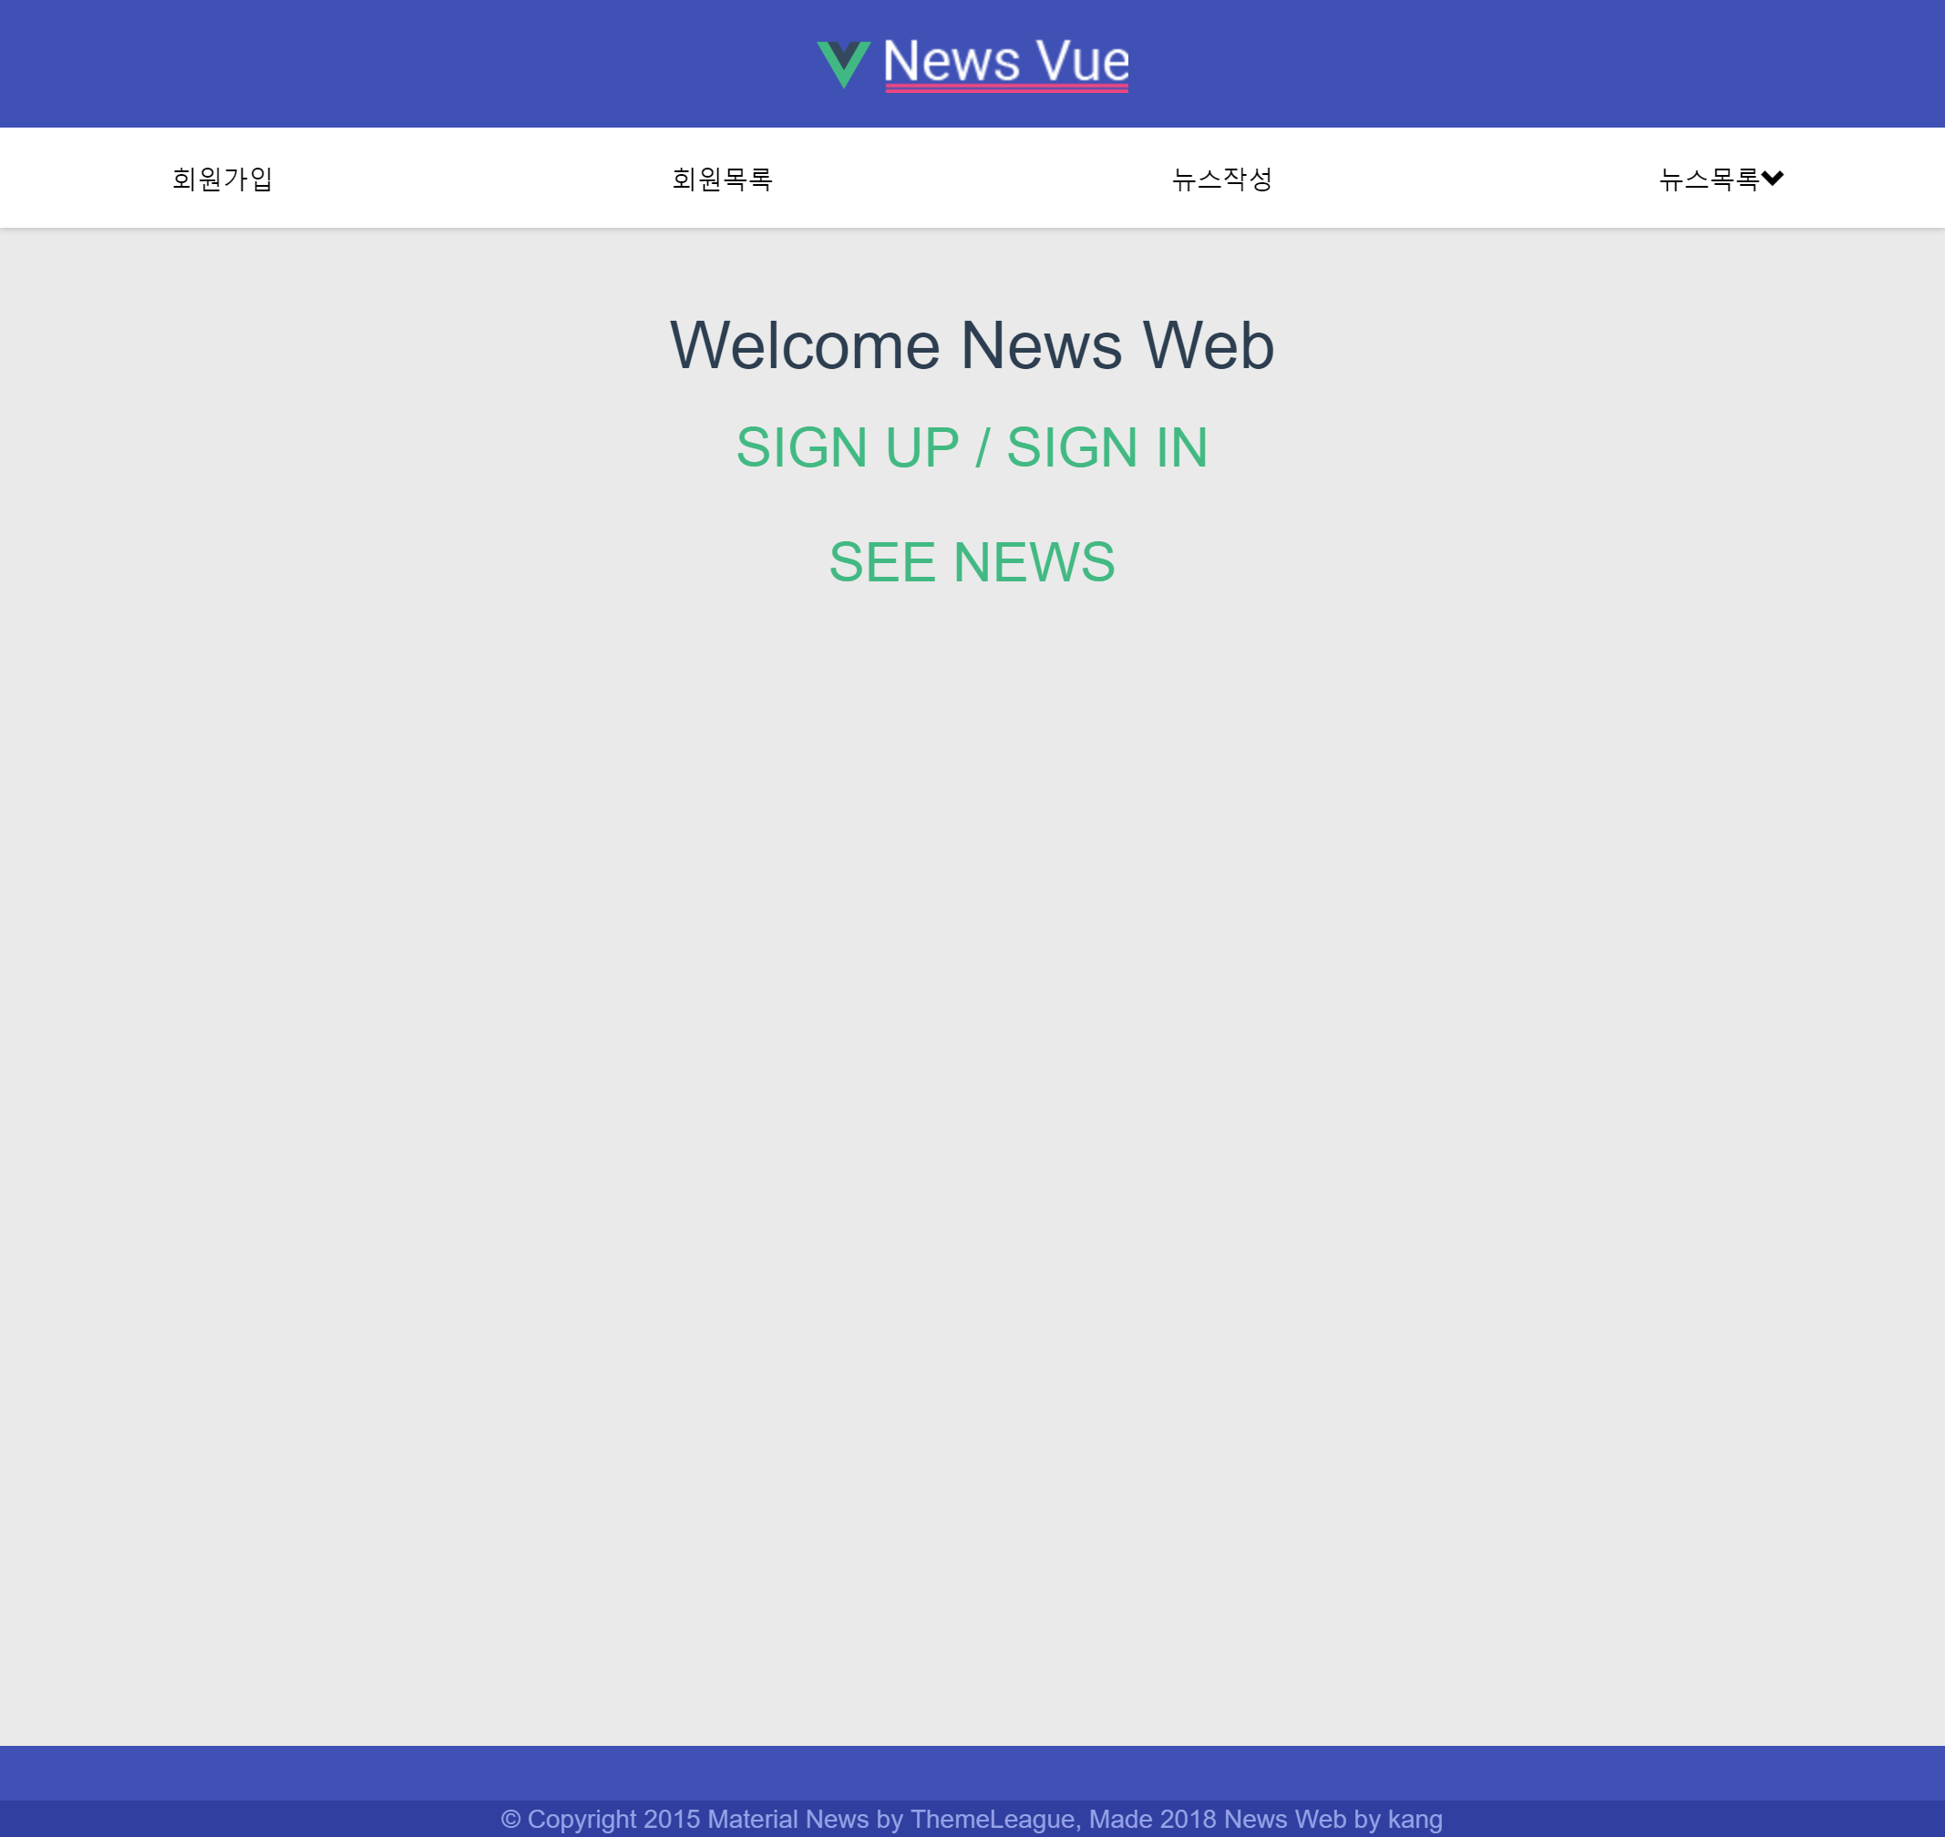
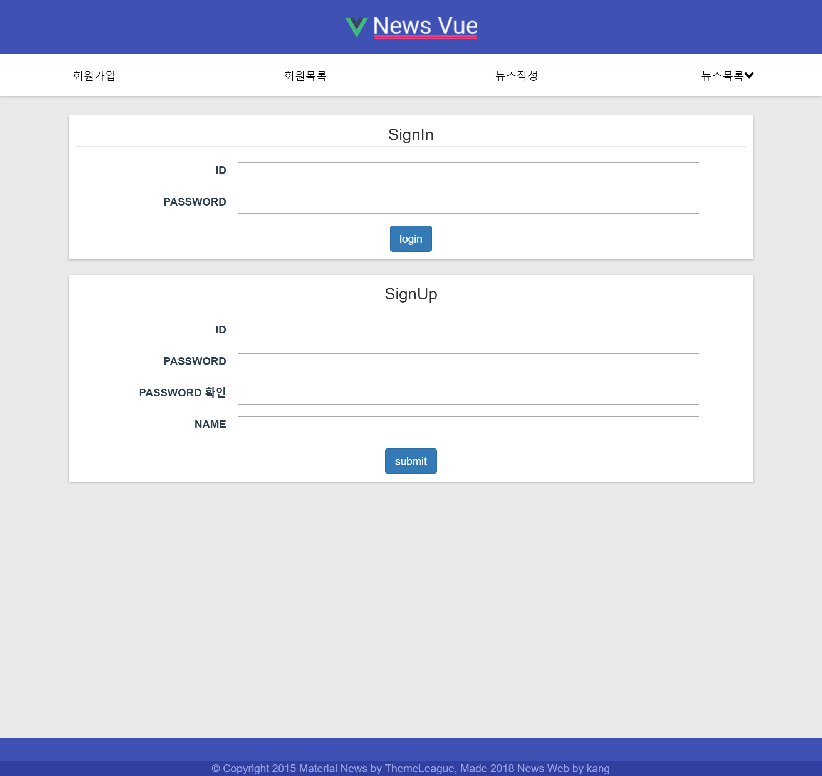
스크린샷
Home
Sign up / Sign in

Slide 12
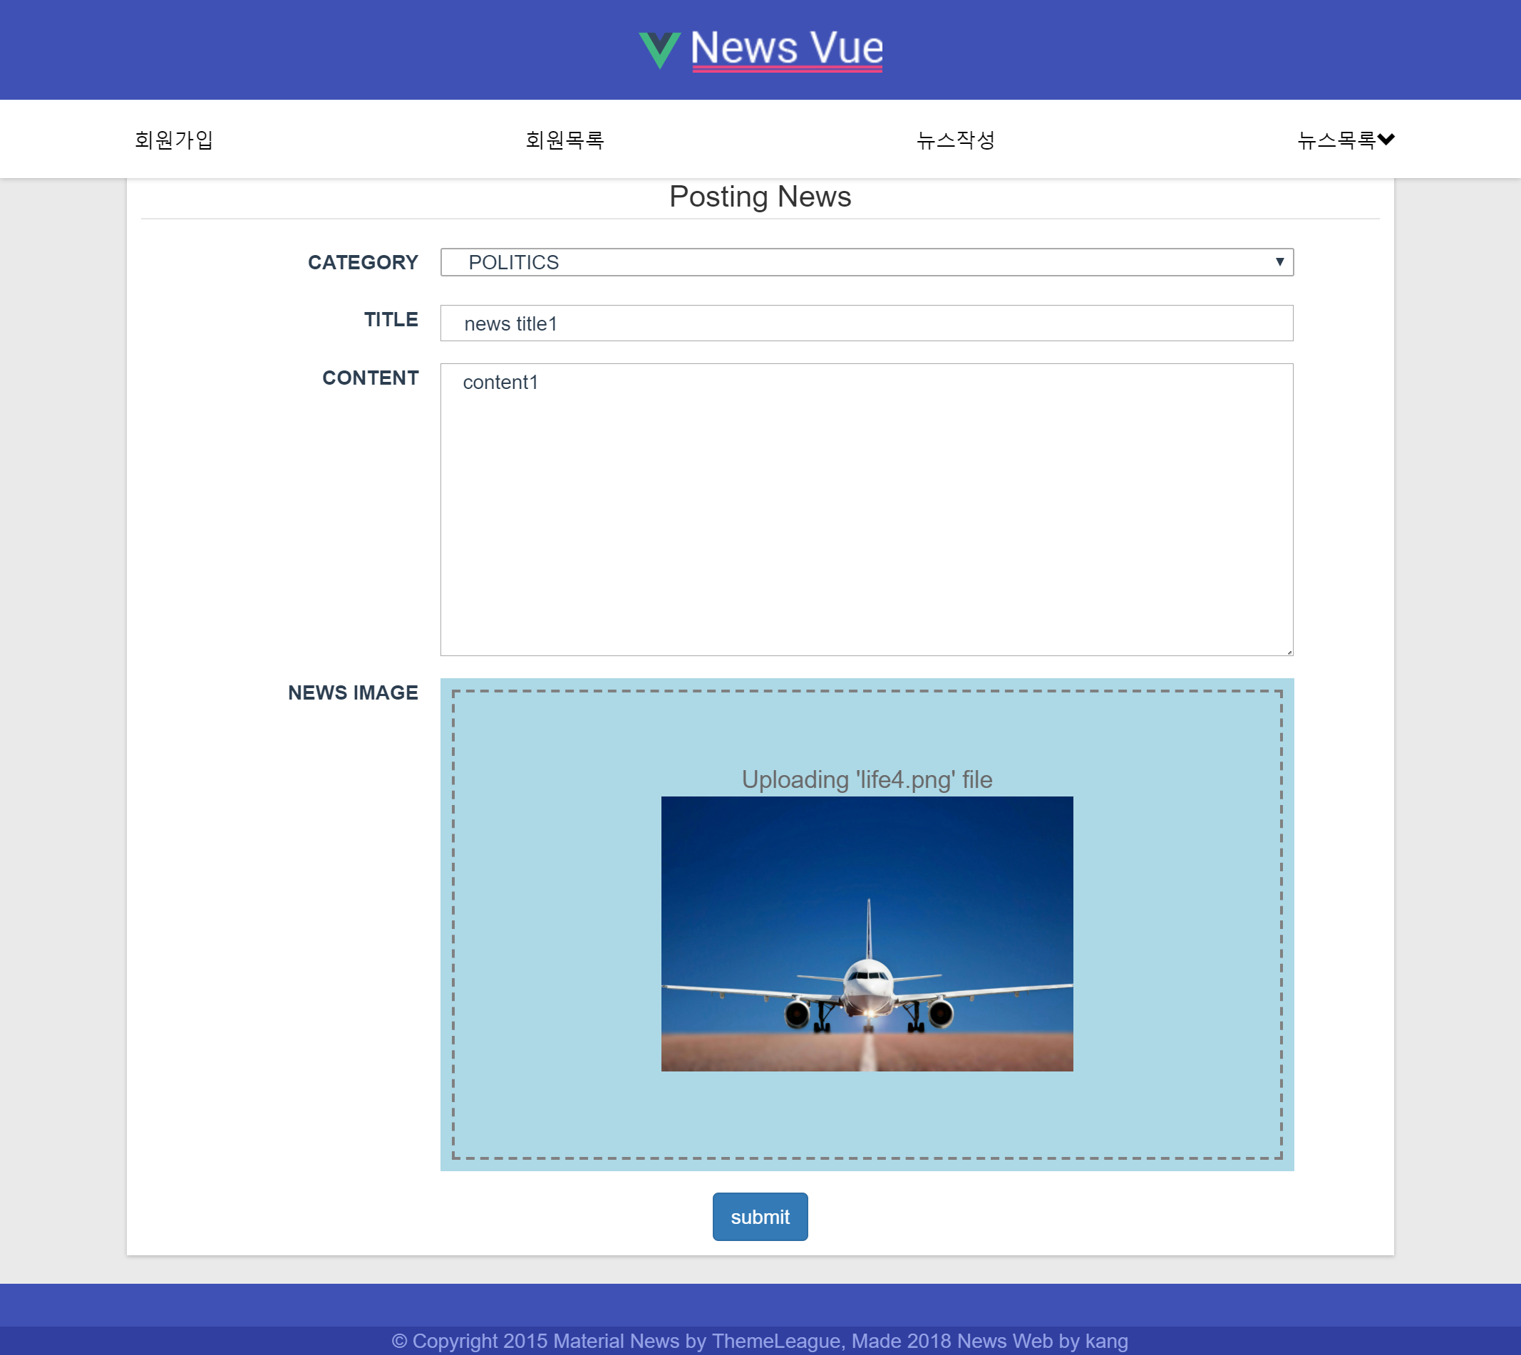
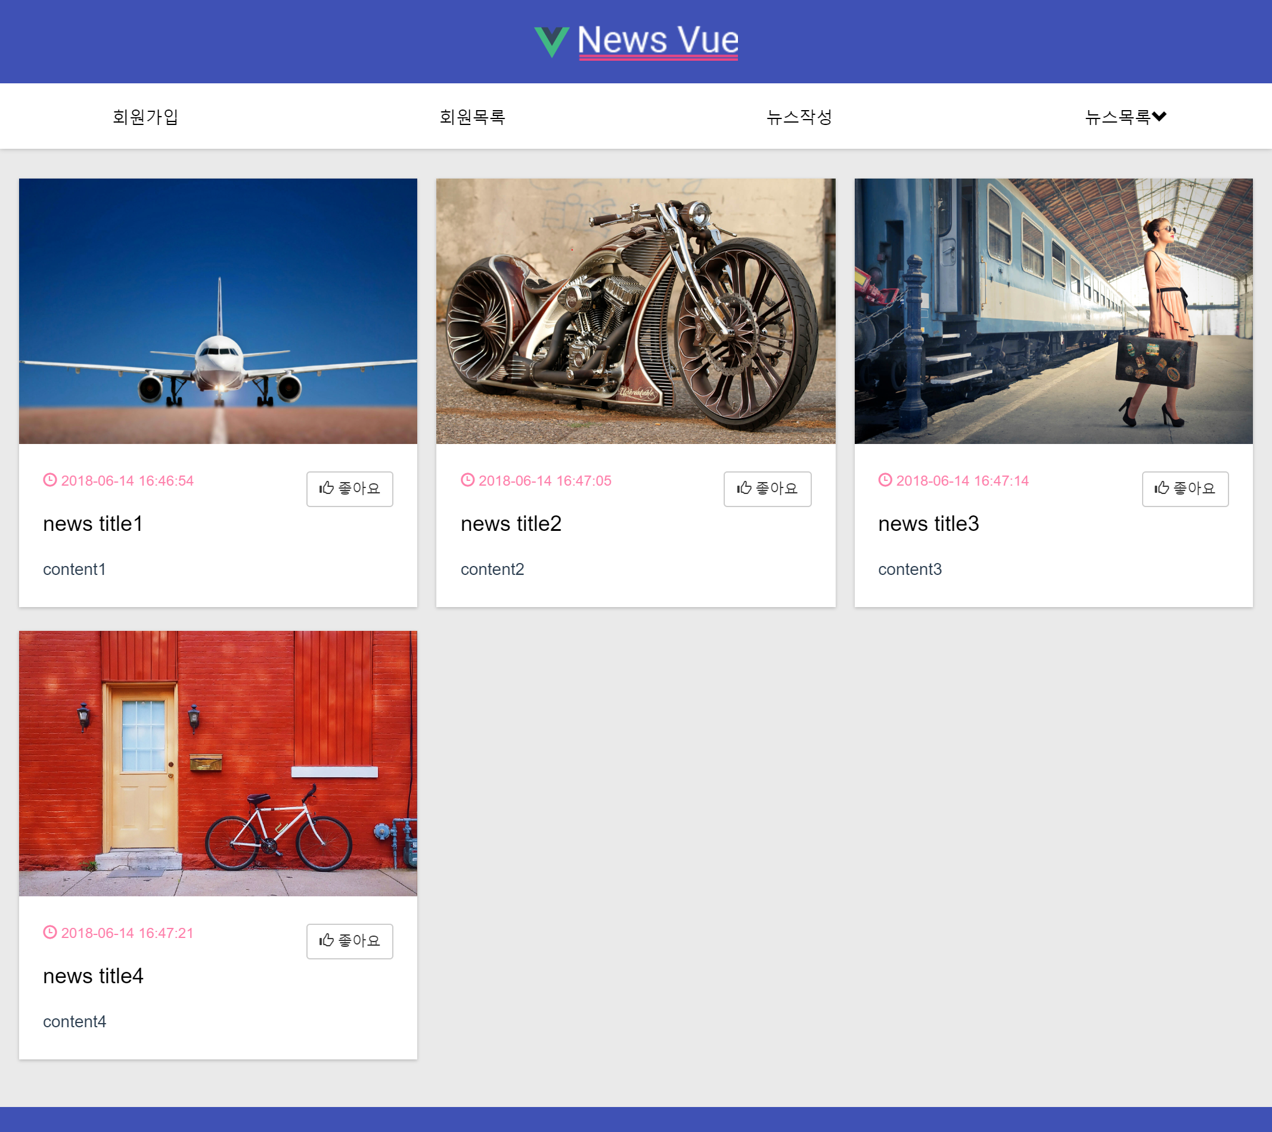
스크린샷
Post news
News List

Slide 13
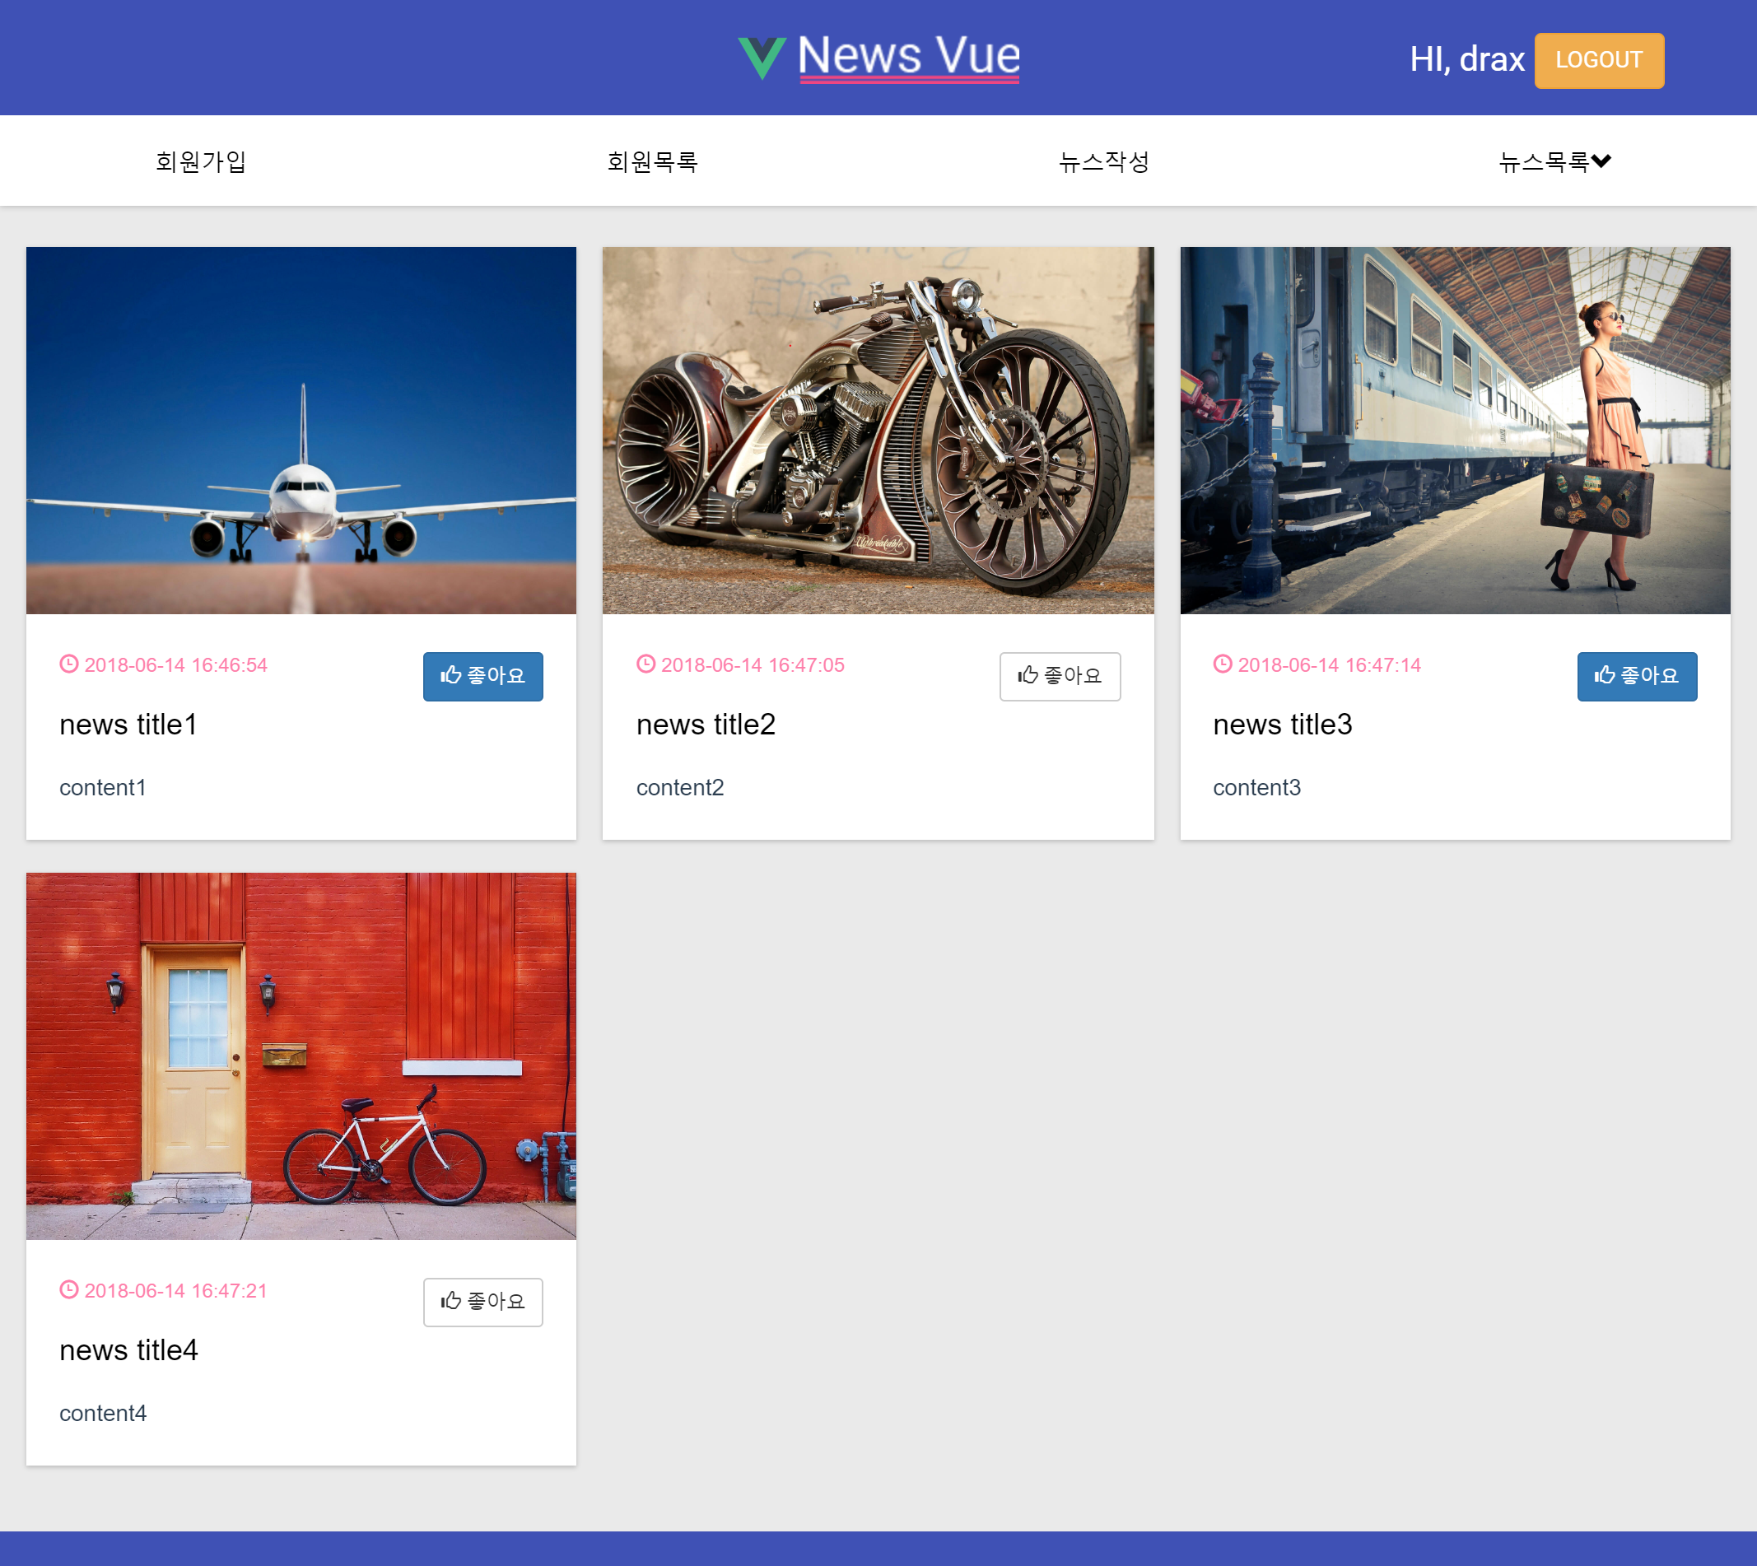
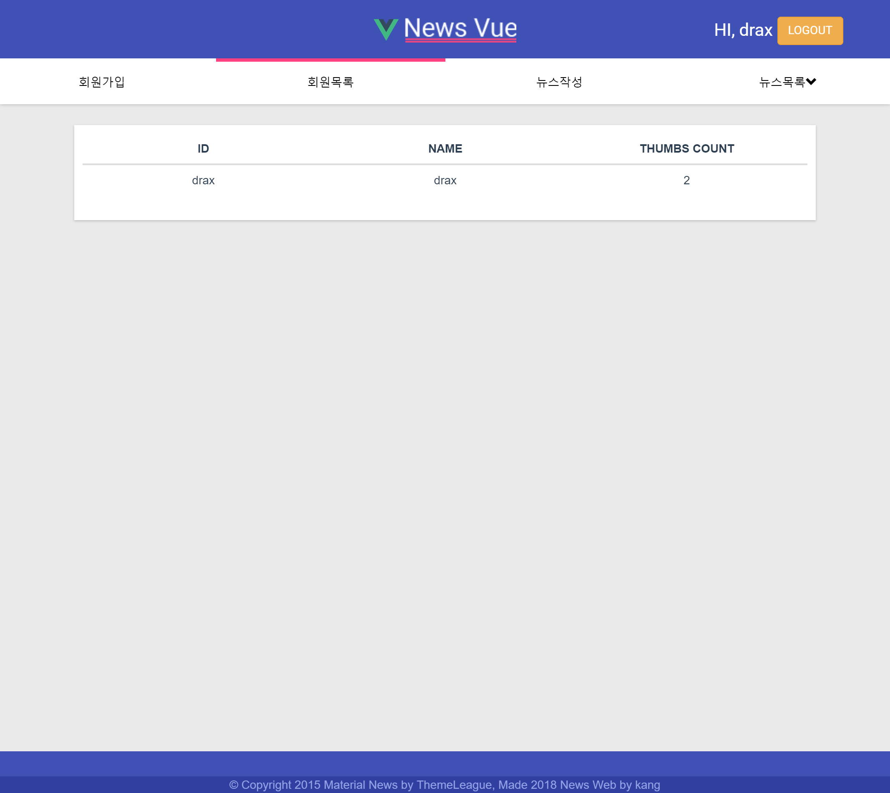
스크린샷
Thumbs Up
Thumbs count

Slide 14
코드 설명
Server: https://github.com/rkdlrl/knews
Client: https://github.com/gachon-it/vue-kang-1

